Slide 1
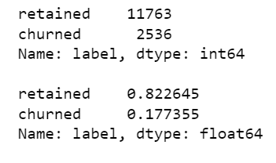
New York City TLC Project Preliminary Data Summary
Executive Summary Report
Project Overview
Waze leadership ask data team to develop a churn predictive model that will help prevent churn. improve user retention, and grow Waze’s business The Waze data team performed a preliminary data inspection.
This datasets has 82.2% retained users and 17.7% churned users
Churned users use more drives, more uses, more kilometers driven, and more hours usage, means their trips are farther and longer but less fewer days usage in a month
This churned users represented in datasets is not a typical users, called super drivers
Check validity for some unusual data
Since some churned users are super drivers, we need to explore more why they are not using this application anymore
Conduct Exploratory Data Analysis (EDA)

